Slide 1
AWS Essentials Day 4 Assignment
Pavan Gantakoru

Slide 2
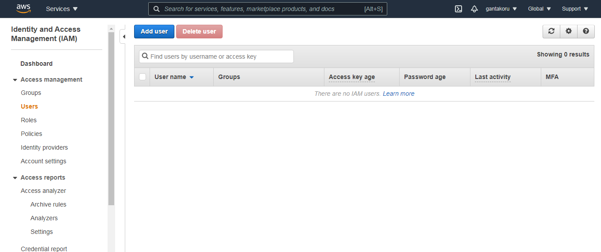

Slide 3
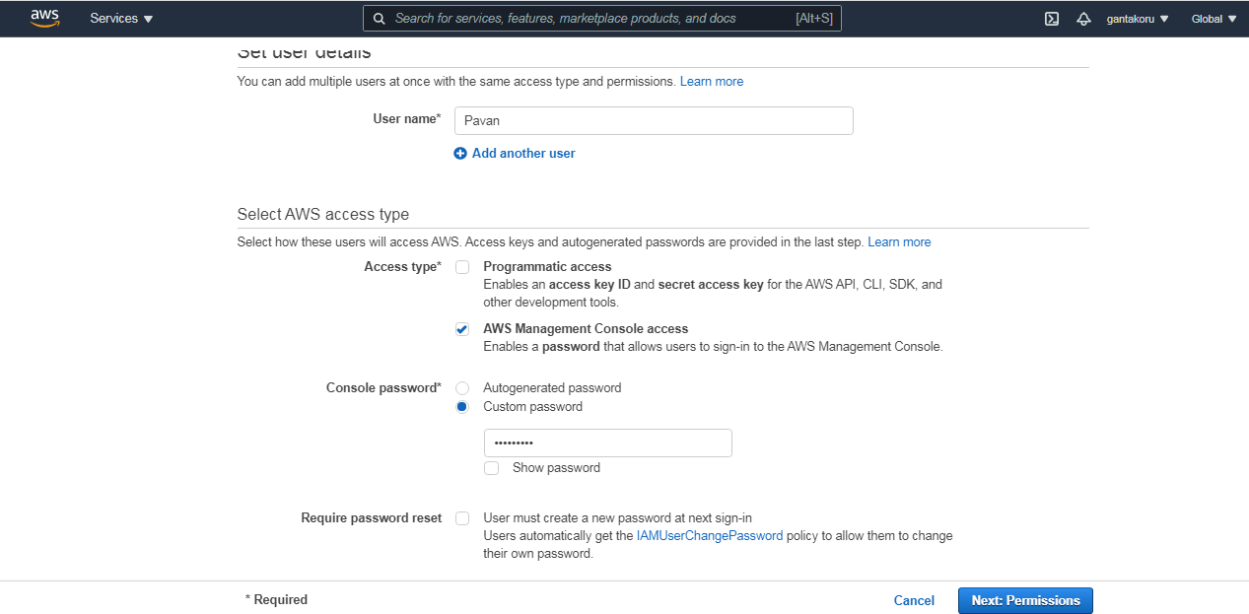

Slide 4
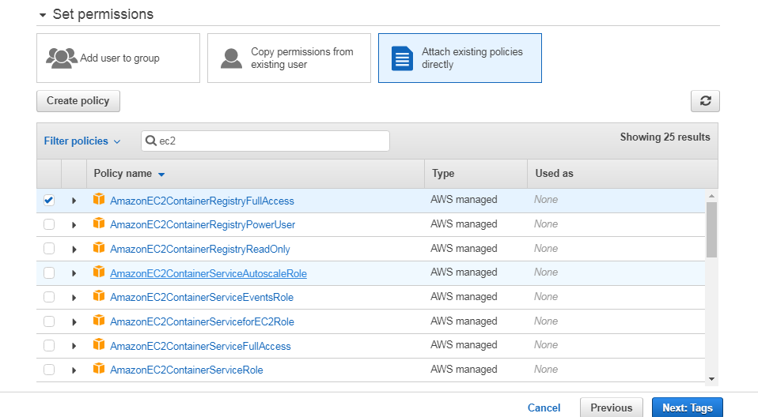

Slide 5

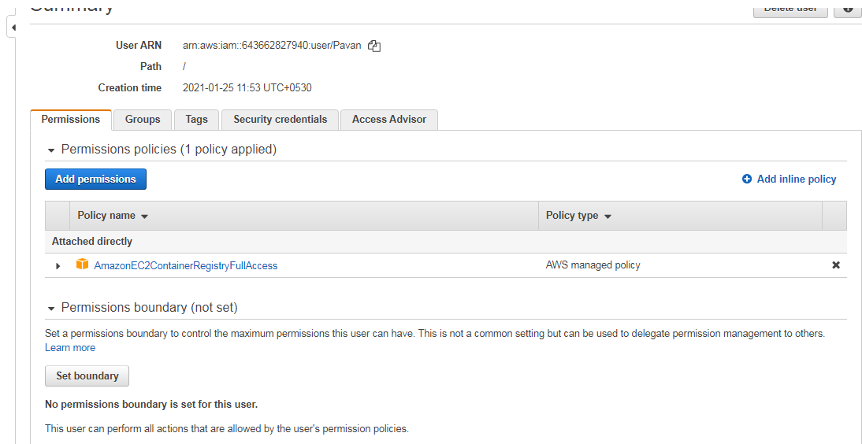

Slide 6
